Slide 1
Week 3 Creating a Docker Container Application in Real World
BY: DINESH STHAPIT

Slide 2
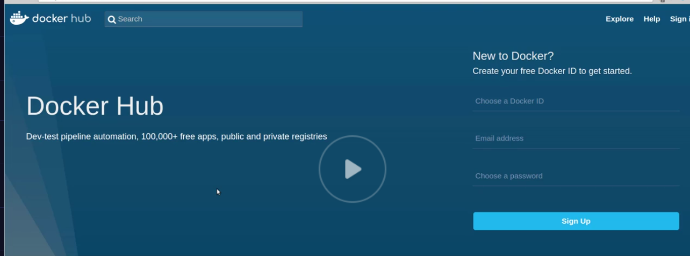
Docker Hub Account
Create a docker hub account

Slide 3
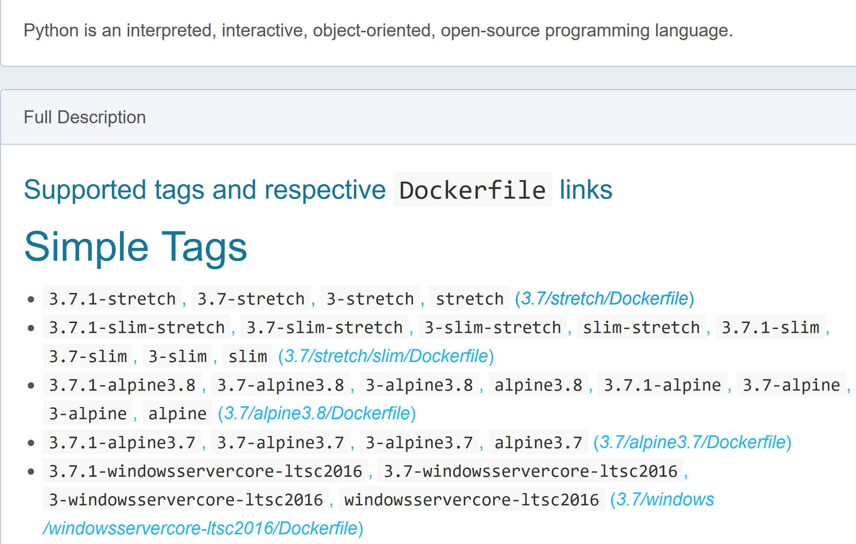
Docker Recipe the Docker File
Start with a base docker image

Slide 4
Lesson Plan
What is layered file system?
What is Container and Volumes?
What is source code?
How to hook a container to source code?
How to remove a container and volumes?
How to clean up container, images?

Slide 5
Creating a container volume
Point the to your source code
Add source code into the custom docker image.

Slide 6

Layered File System
Base Operating System Image (alpine Linux)
SDK (Framework Node modules)
SDK (Framework Node modules)
Read Only
Immutable Image Layers
Apk packages (dependency)

Slide 7


Layered File System + Writable File System
READ/WRITE Ephemeral Storage
Container
File System
Base Operating System Image (alpine Linux)
SDK (Framework Node modules)
SDK (Framework Node modules)
Read Only
Baked Image Layers
Apk packages (dependency)

Slide 8
Shared Image Layers
READ/WRITE Ephemeral Storage
READ/WRITE Ephemeral Storage
READ/WRITE Ephemeral Storage
Base Operating System Image (alpine Linux)
SDK (Framework Node modules)
SDK (React.JS)
SDK (Mangoose)
SDK (Framework Node modules)
MangoDB
Apk packages (dependency)

Slide 9
Stop

Slide 10

Volumes
Volumes are special types of Directory in the Host OS file system
These Volumes can be shared across Containers
One or more volumes can be attached to a container
The volumes can live beyond the life of the container
Changes to Docker images will not effect the data stored in the volumes. The data stored in the volumes are persisted even after the images are deleted.

Slide 11

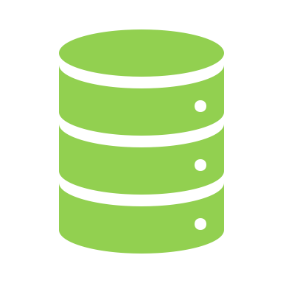

Docker Volumes
/mnt/node/source…
/var/www

Slide 12
Docker managed Container Volume https://docs.docker.com/engine/reference/commandline/volume_inspect/ https://docs.docker.com/engine/reference/commandline/volume_ls/
> docker run –p 27017:27017 -v /var/www mongo
Create Docker Volume
Inside Container Volume mount Point
> docker container ls
STATUS PORTS NAMES
cf9f3ae92bd6 mongo "docker-entrypoint.s…" 25 seconds ago
> docker inspect cf9f3ae9

Slide 13
docker container inspect <containerID>
…………
"Mounts": [
{
"Type": "volume",
"Name": "002a227f300fda914237cb08f8cba9bffd75a811d8799ccf5fd2869bd16733a6",
"Source": "/var/lib/docker/volumes/002a227f300fda914237cb08f8cba9bffd75a811d8799ccf5fd2869bd16733a6/_data",
"Destination": "/data/configdb",
"Driver": "local",
"Mode": "",
"RW": true,
"Propagation": ""
},
………..

Slide 14
Docker custom Container Volume
Current Working Directory in the Host Path
Inside Container Volume mount Point
> pwd /user/xxxxxxx
> docker run –p 27017:27017 –v $(pwd):/var/www mongo
> docker container ls
STATUS PORTS NAMES
30a2fc11da. mongo "docker-entrypoint.s…" 25 seconds ago
> docker inspect 30a2fc11da
Or name of the container “mongo”

Slide 15
docker container inspect <containerID>
…………
" "Mounts": [
{
"Type": "bind",
"Source": "/Users/xxxxxxxx",
"Destination": "/var/www",
"Mode": "",
"RW": true,
"Propagation": "rprivate"
},
………..

Slide 16
Stop…

Slide 17

Containerizing a Node.js Server
Download your code for FSW 135 Node Server Code
Run -> npm install
Or Create a new Node Server
Run -> npm install express express-generator –g
express ExpressSite –hbs
cd ExpressSite && npm install
Test the Node server
npm start
If you need open the browser and type localhost:3000
For Mac Users use sudo

Slide 18
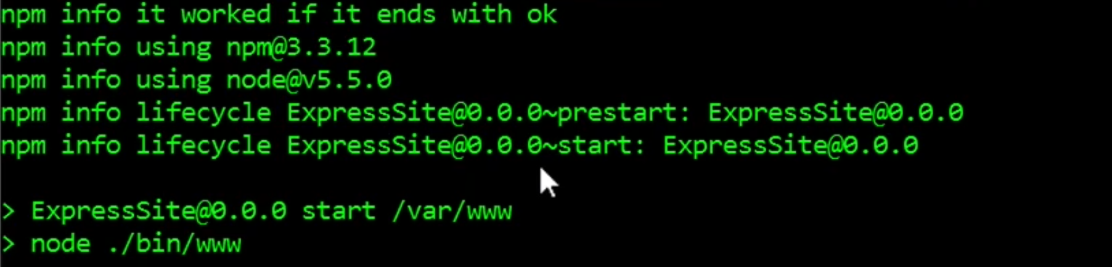
Adding your source code to Docker Container
Change your working directory where you have your node server code
External
Internal
External
Internal
> docker run –p 8080:3000 –v $(pwd):/var/www \
-w “/var/www” node npm start

Slide 19


IPCONFIG / IFCONFIG(Mac)
en0: flags=8863<UP,BROADCAST,SMART,RUNNING,SIMPLEX,MULTICAST> mtu 1500
options=400<CHANNEL_IO>
ether 78:4f:43:97:9e:64
inet6 fe80::1068:b4bc:32b6:def7%en0 prefixlen 64 secured scopeid 0x5
inet 192.168.86.179 netmask 0xffffff00 broadcast 192.168.86.255
nd6 options=201<PERFORMNUD,DAD>
media: autoselect
status: active

Slide 20
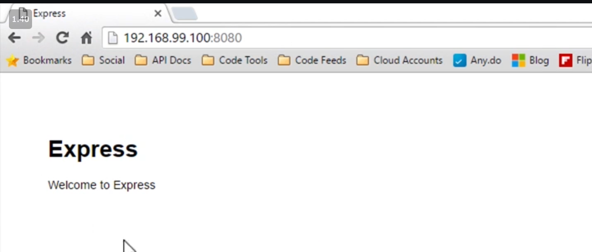
Find the IP of your Host Machine; docker run –p 8080:3000 –v $(pwd):/var/www \ -w “/var/www” node npm start
Open the browser and type 192.168.86.179:8080

Slide 21


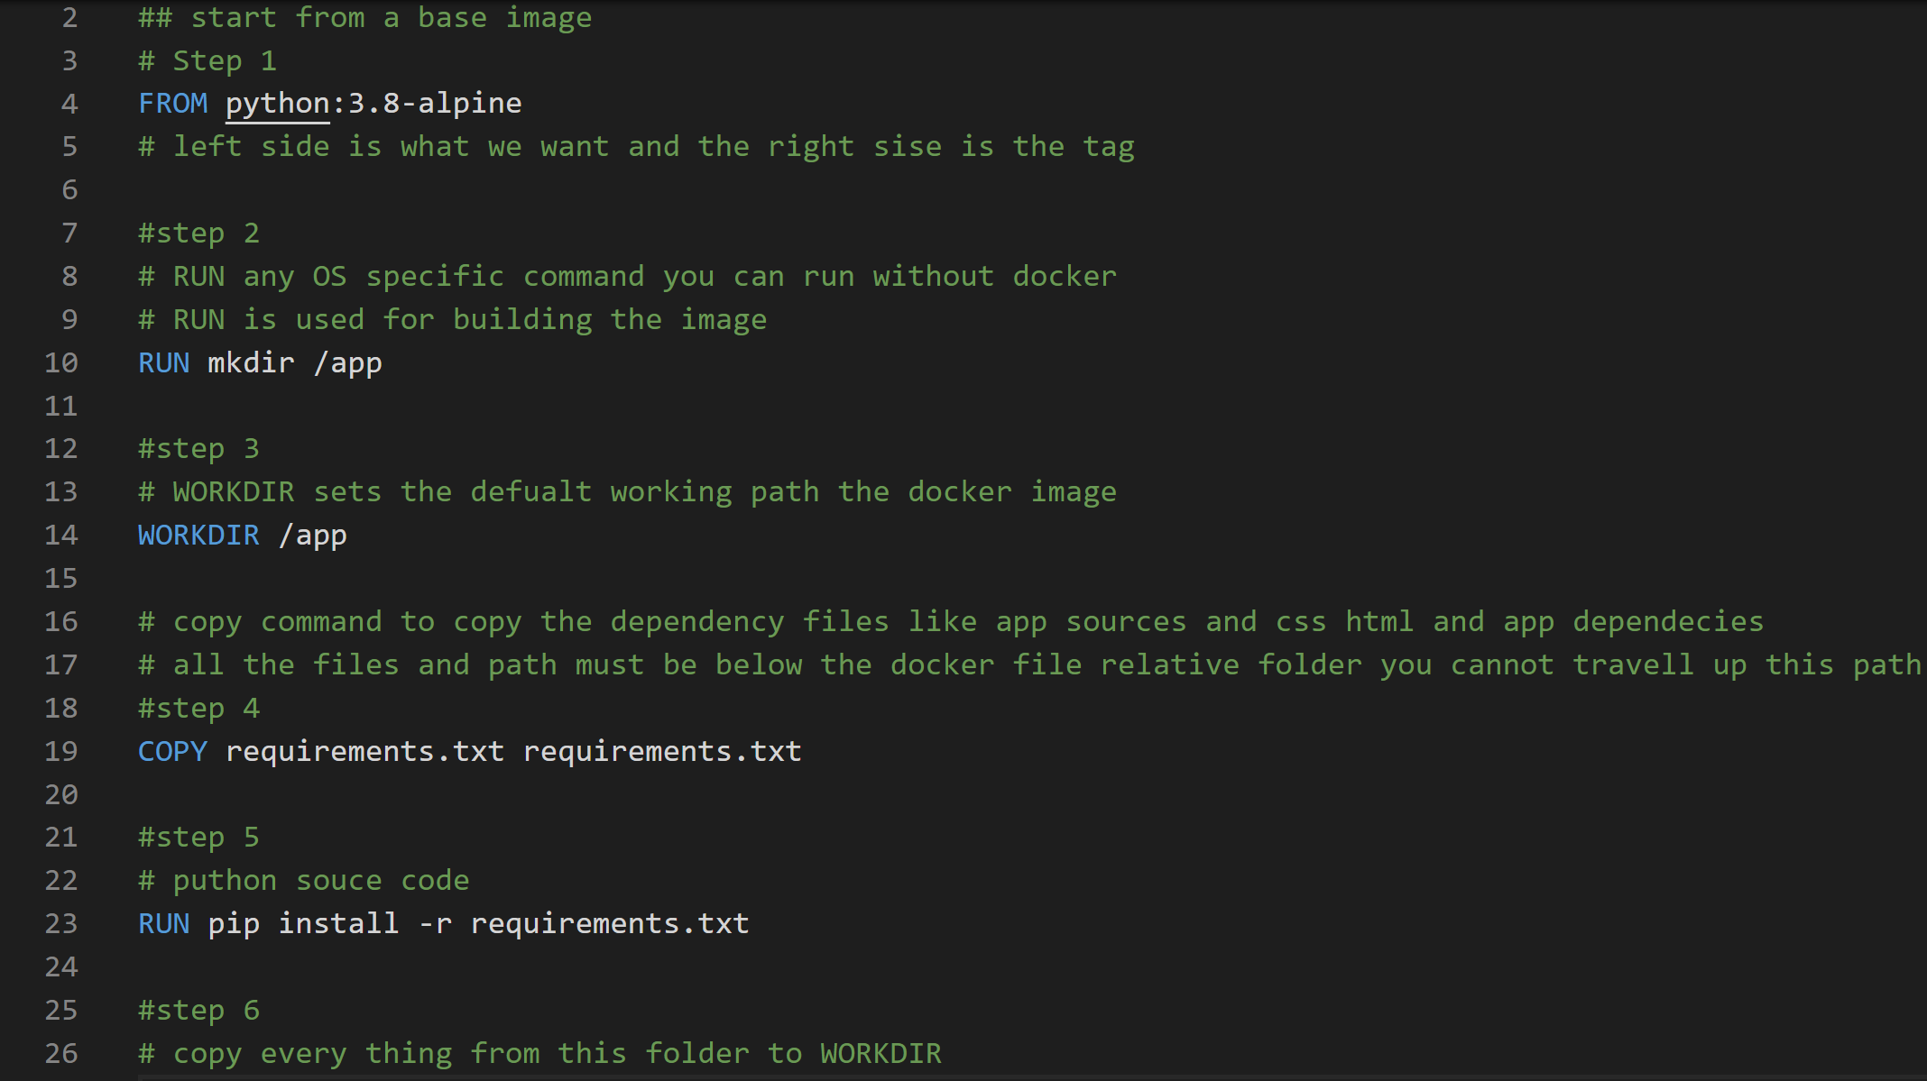




Slide 23
Docker Build Process
Step 1:
Create a Folder to Start a Docker Project
Step 2:
Create The Docker File name “dockerfile”. The docker blue print
Start configuring the docker configuration steps
Step 3:
Build the docker image by executing the docker command

Slide 24
Docker file
FROM python:3.7-alpine
RUN mkdir /app
WORKDIR /app
COPY requirements.txt requirements.txt
RUN pip install -r requirements.txt
COPY . . LABEL maintainer="Dinesh Sthapit <dsthapit@asu.edu>" version="1.1"
CMD flask run --host=0.0.0.0 --port=5000

Slide 25
The order of the commands do matter
FROM python:3.7-alpine
RUN mkdir /app
WORKDIR /app
COPY requirements.txt requirements.txt
RUN pip install -r requirements.txt
COPY . .
FROM python:3.7-alpine
RUN mkdir /app
WORKDIR /app
COPY requirements.txt requirements.txt
COPY . .
RUN pip install -r requirements.txt
This is does not change it is Cached
And will create amore lean image
Pip install will run every time you make changes to the bundle

Slide 26
Docker Command Line Instructions(CLI)
Step1 :
docker --help
There are two category of docker commands
Management
Other regular commands

Slide 27
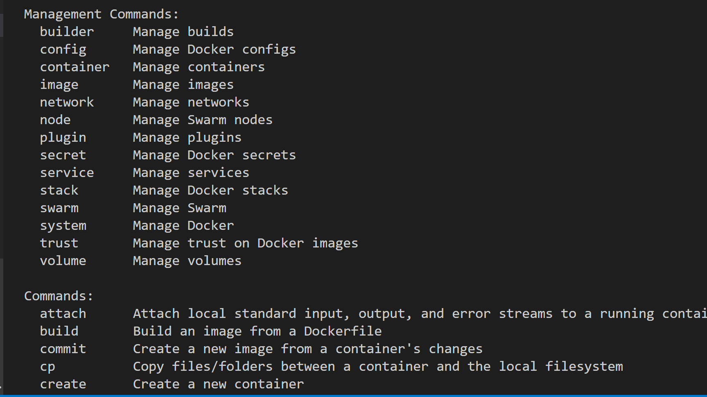

Slide 28
Build Docker Image
Step 1:
Start command shell in the location where your dockerfile is located
Command
docker image build –t web01 .
Options -t, --tag list
Name and optionally a tag in the
'name:tag' format
For other options type docker build --help

Slide 29
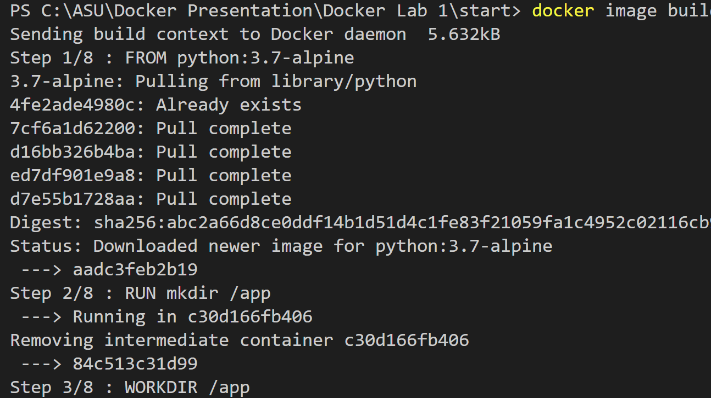

Slide 30
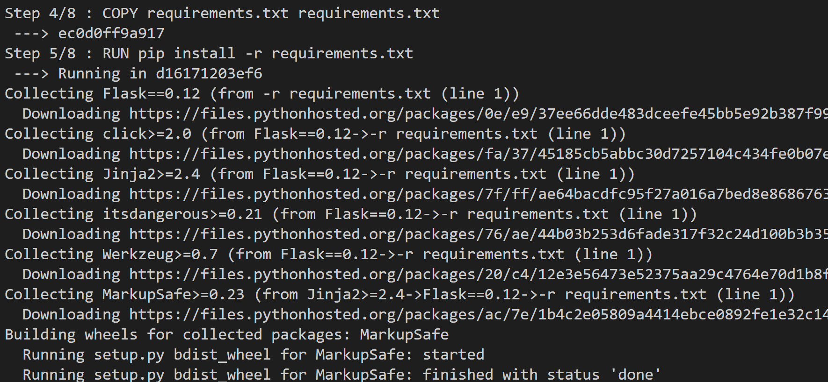

Slide 31
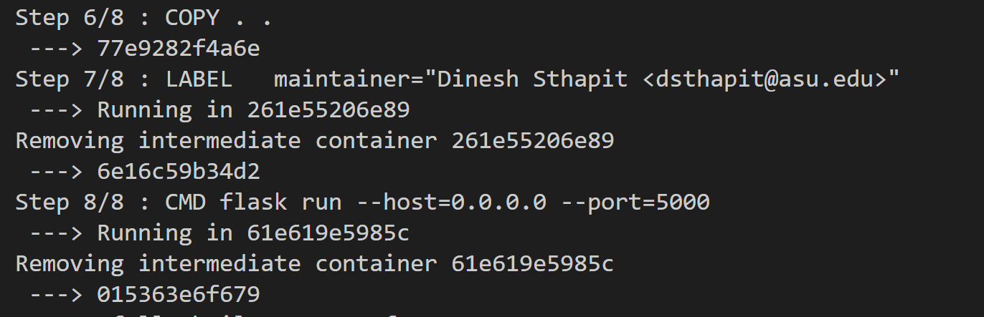
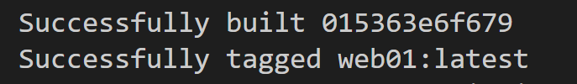

Slide 32
Docker cache
Step 2:
Run the same command once again
docker image build –t web01 .

Slide 33
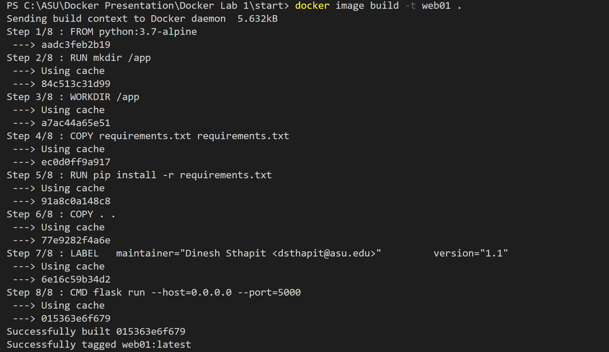

Slide 34
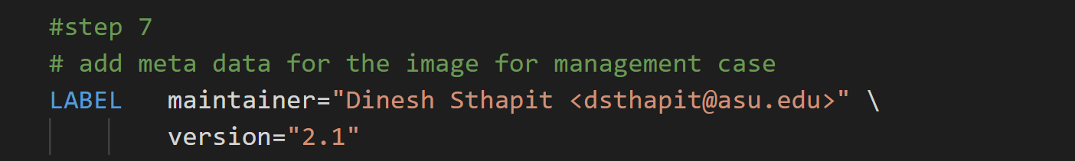
Docker layered File System
Step 3:
Change the contents of the dockerfile
Step 4:
docker image build –t web01 .

Slide 35
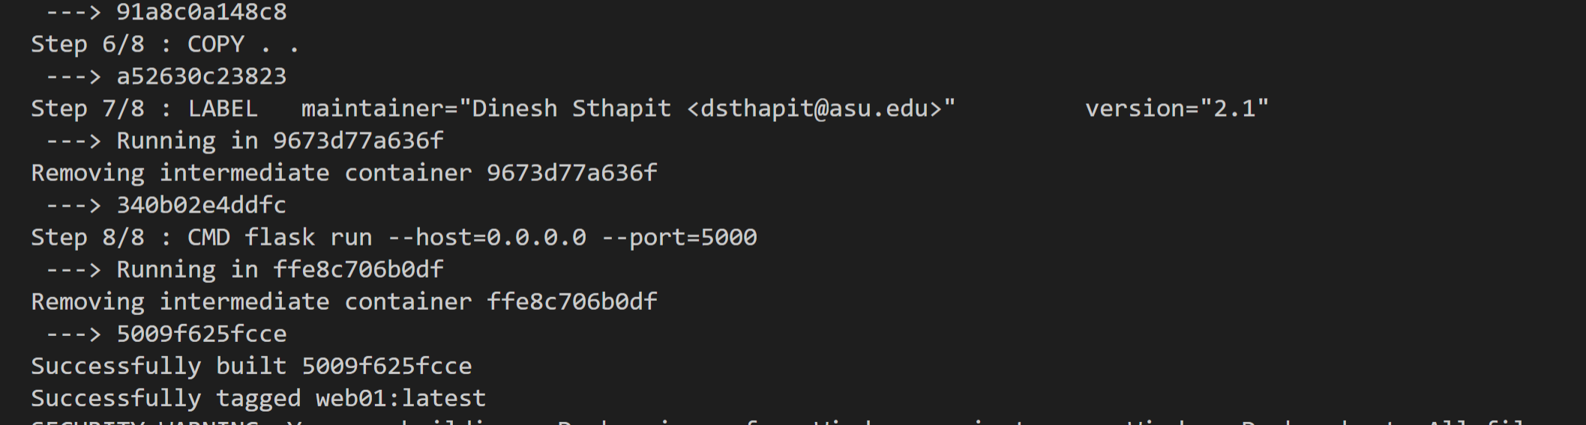

Slide 36
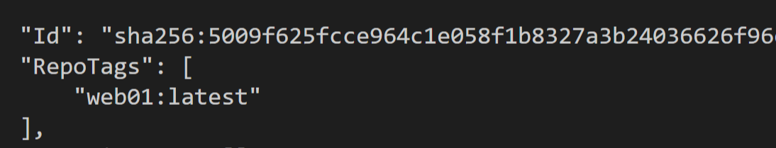
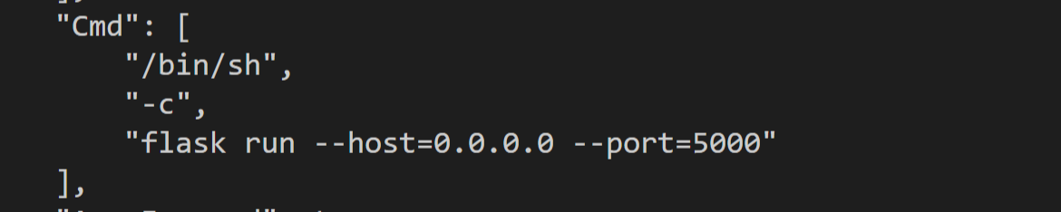
Docker Inspect Command
docker image inspect web01

Slide 37
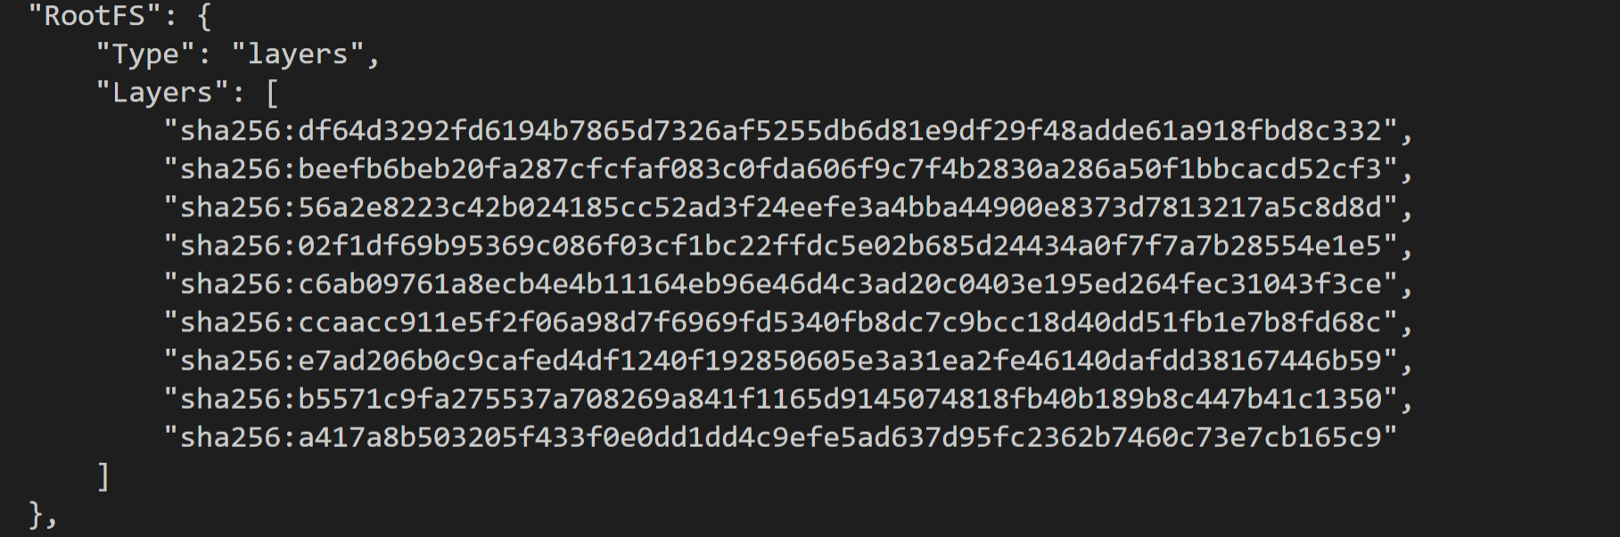
Docker layered File System

Slide 38
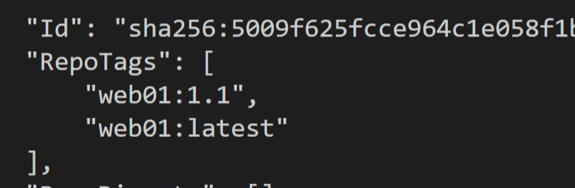
Docker Build with a specific version
Step 6:
docker image build –t web01:1.1 .
Step 7:
docker image inspect web01

Slide 39
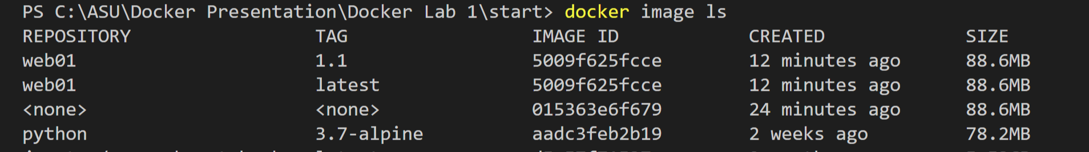
Docker Management Commands
Step 8:
docker image ls

Slide 40
Docker Management Commands Remove images
Step 8:
docker image rm web01:1.1
Or
docker image rm [image id]
Step 9: Verify
docker image ls

Slide 41
Pushing the Docker Image to Docker Hub
Step 10:
docker login
Will store the credential for future use in
[User Profile]/.docker/config.json
Step 11:
You will need to tag the image using your dockerID
docker image tag web01 [userID]/web01:latest
docker image ls (verify)
Step 12:
docker image push [userID]/web01:latest

Slide 42
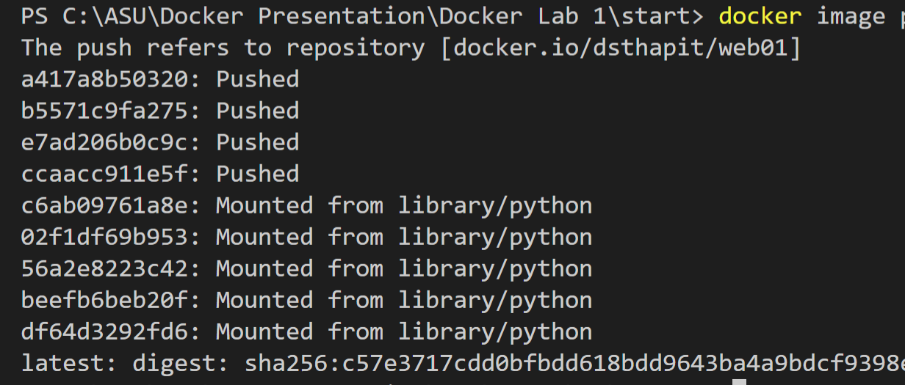
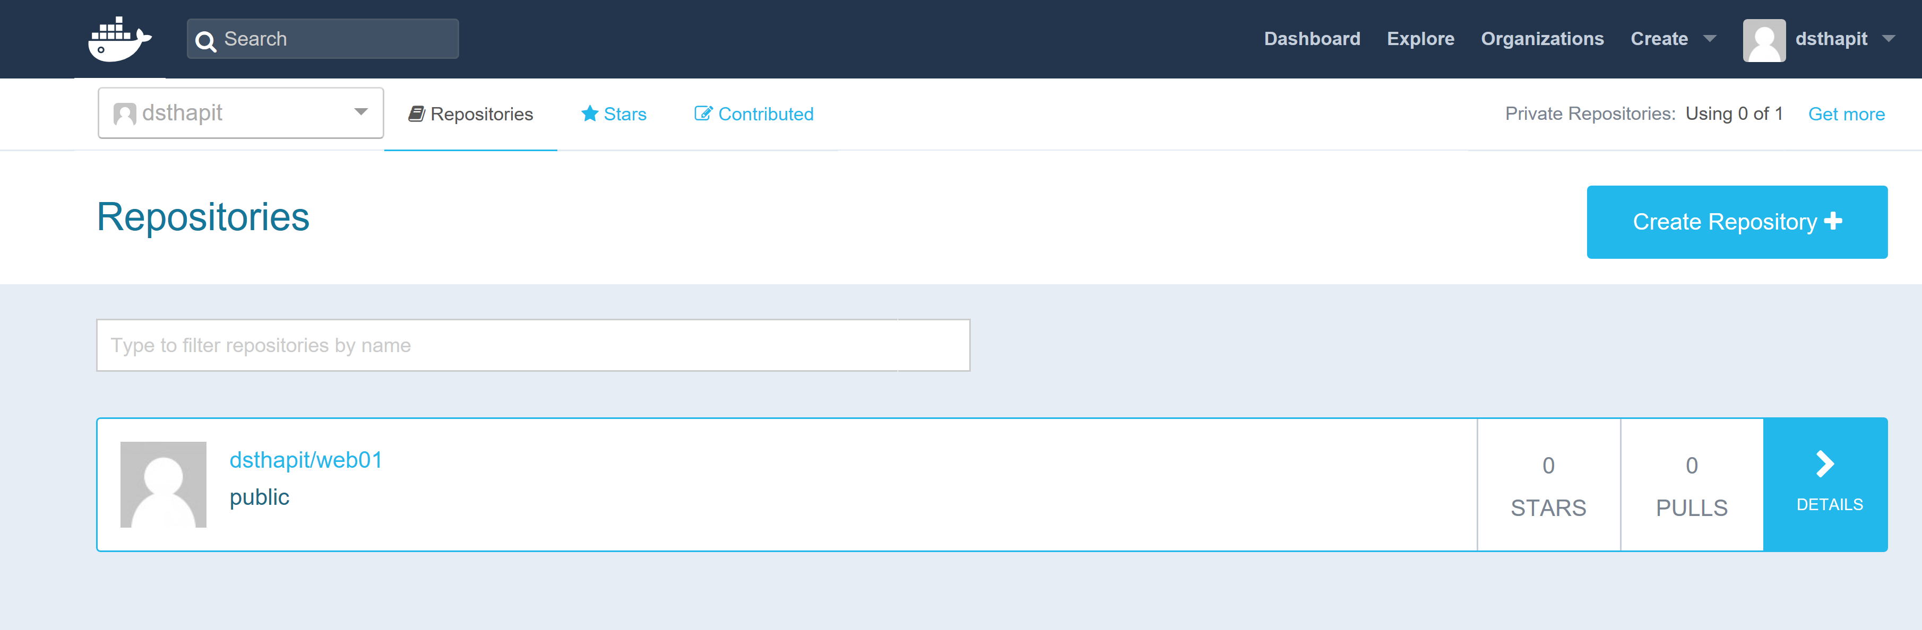

Slide 43
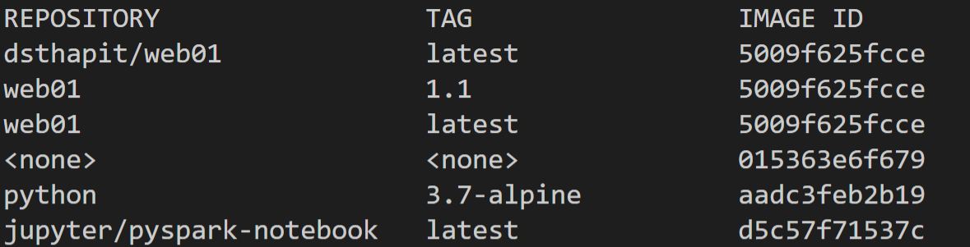
Clean Up Labs resources
Step 13:
docker image ls
Step 13:
docker image rm –f [imageID]
docker image ls (verify)

Slide 44
Pulling Docker Image from Docker HUB
Step 14:
docker pull dsthapit/web01:latest
docker image ls (verify)

Slide 45
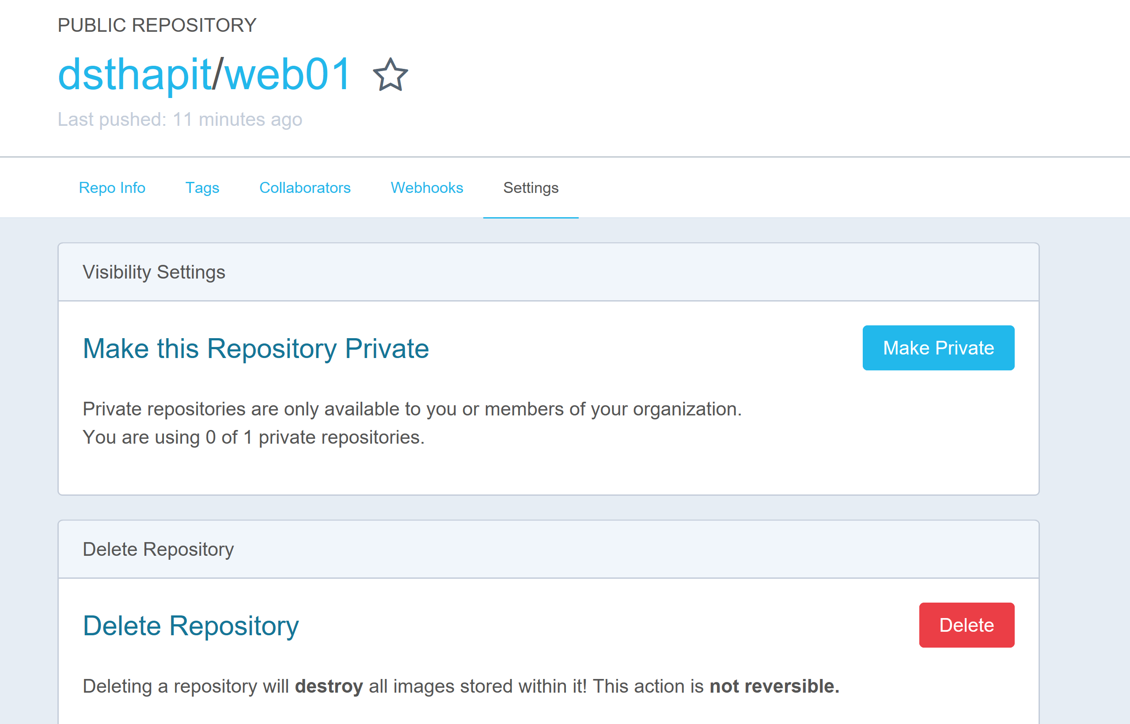
Clean Up Docker Hub Repository

